Slide 1
ELECS212
Network
Programming and Design
Tutorial 7 for group 1 & 2
(Lab 1.5 )
Course Coordinator : Dr. Steven Choy
Tutor : Mr. Lee, Bo-sing (Joe)
URL of my teaching website : http://learn.ouhk.edu.hk/~t441051/s212
P.<number>
Notes:
CT212 (02/03)-Network Programming and design
27 April, 2002
School of Science & Technology

Slide 2
Agenda
What is network analysis
Download Wireshark (Step 1)
Installation of Wireshark & WinPCap (Step 1)
Start Wireshark (Step 2)
Understand display filter of Wireshark (step 3)
Capture wired traffic using Wireshark (step 4)
(Optional) Capture wireless traffic using Wireshark
P.<number>
Notes:
CT212 (02/03)-Network Programming and design
27 April, 2002
School of Science & Technology

Slide 3
What is Network analysis
Different terms are used for Network analysis
  Traffic analysis
  Protocol analysis
  Packet analysis
  Packet sniffing
  ….
Network analysis involves following steps
  Identify packet type to be captured (eg. http only, smtp only, TCP only, UDP only, etc)
  Capture specified traffic using tools such as packet sniffer, or Wireshark (formerly called Etherreal), Nmap & Angry IP. The latter 3 are free.
  Analyze captured packet to find out what happen, IP address of hacker, which type of hacking method is using, etc.
P.<number>
Notes:
CT212 (02/03)-Network Programming and design
27 April, 2002
School of Science & Technology

Slide 4
What is Wireshark
Wireshark is free & software-based
It earns its reputation and many network expertise regard it as de-facto network analysis tool
It can capture packets from different types of interface such as standard Ethernet, PPP and VPN.
It requires Windows Packet Capture package (WinPcap). Wireshark is included with WinPcap but the version may NOT be most update.
It is better to install the latest Winpcap first instead of using versions included with Wireshark.
P.<number>
Notes:
CT212 (02/03)-Network Programming and design
27 April, 2002
School of Science & Technology

Slide 5
Lab 1.5 – Step 1
Download latest version WinPCap for windows
  http://www.winpcap.org/install/default.htm
  Stable version on 8/3/2018 is 4.1.3
Download wireshark for windows (32 bit or 64 bit depending on your CPU and OS)
  http://www.wireshark.org/download.html
  Stable version on 8/3/2018 is 2.4.5
Install downloaded WinCap by double clicking it
Install downloaded Wireshark by double clicking it. Don’t include installing WinCap.
P.<number>
Notes:
CT212 (02/03)-Network Programming and design
27 April, 2002
School of Science & Technology

Slide 6
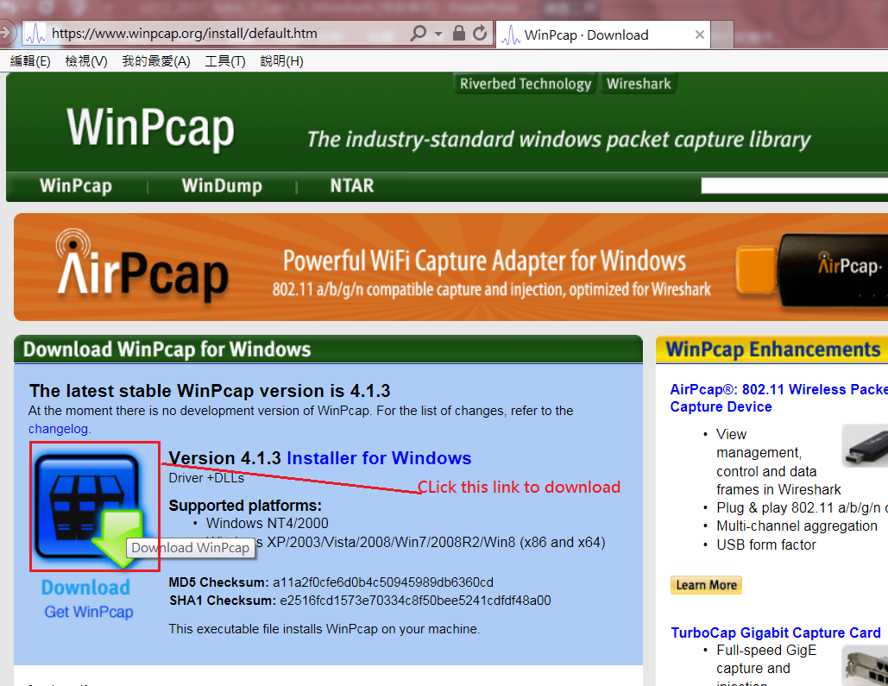
Lab 1.5 – Step 1: Download WinPcap
P.<number>
Notes:
CT212 (02/03)-Network Programming and design
27 April, 2002
School of Science & Technology

Slide 7
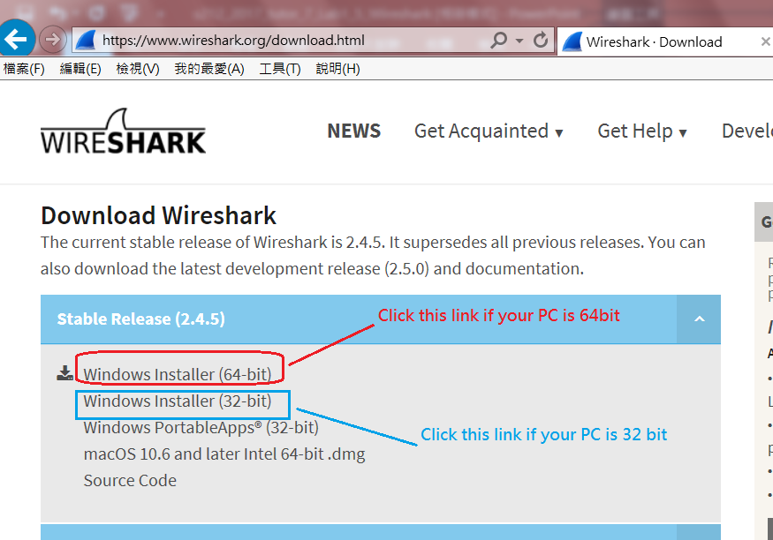
Lab 1.5 – Step 1: Download Wireshark
P.<number>
Notes:
CT212 (02/03)-Network Programming and design
27 April, 2002
School of Science & Technology

Slide 8
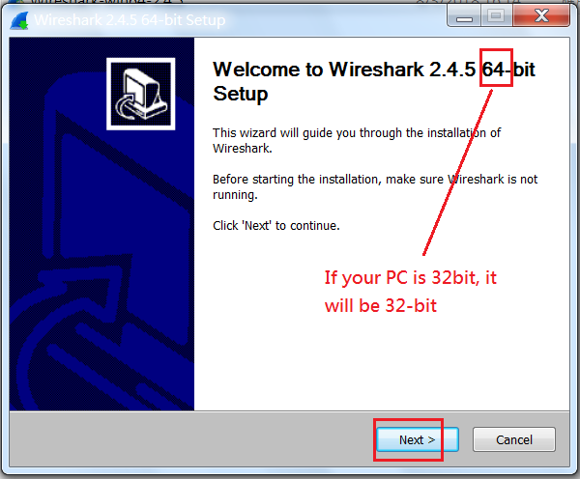
Lab 1.5 – Step 1: Install Wireshark (1)
P.<number>
Notes:
CT212 (02/03)-Network Programming and design
27 April, 2002
School of Science & Technology

Slide 9
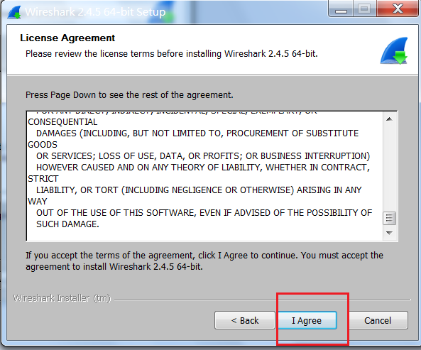
Lab 1.5 – Step 1: Install Wireshark (2)
P.<number>
Notes:
CT212 (02/03)-Network Programming and design
27 April, 2002
School of Science & Technology

Slide 10
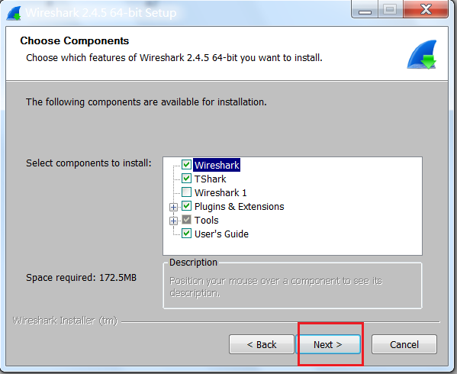
Lab 1.5 – Step 1: Install Wireshark (3)
P.<number>
Notes:
CT212 (02/03)-Network Programming and design
27 April, 2002
School of Science & Technology

Slide 11
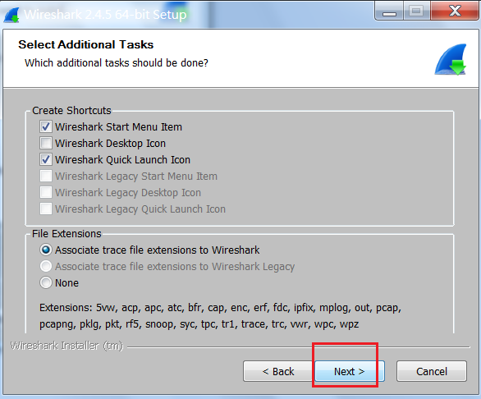
Lab 1.5 – Step 1: Install Wireshark (4)
P.<number>
Notes:
CT212 (02/03)-Network Programming and design
27 April, 2002
School of Science & Technology

Slide 12
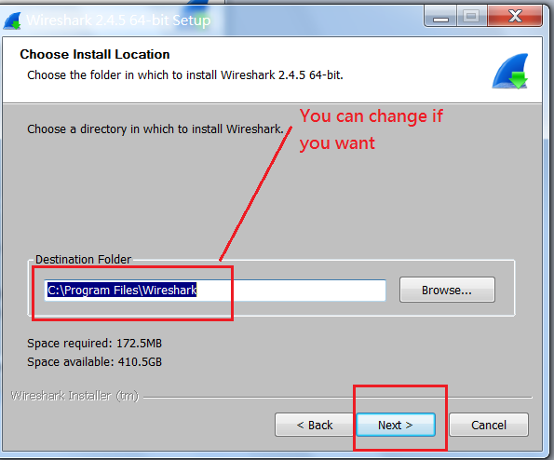
Lab 1.5 – Step 1: Install Wireshark (5)
P.<number>
Notes:
CT212 (02/03)-Network Programming and design
27 April, 2002
School of Science & Technology

Slide 13
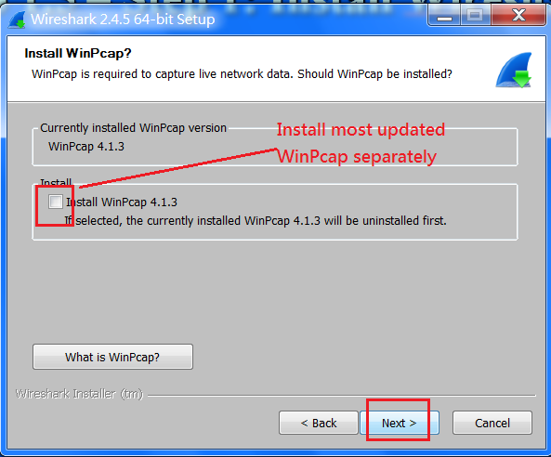
Lab 1.5 – Step 1: Install Wireshark (6)
P.<number>
Notes:
CT212 (02/03)-Network Programming and design
27 April, 2002
School of Science & Technology

Slide 14
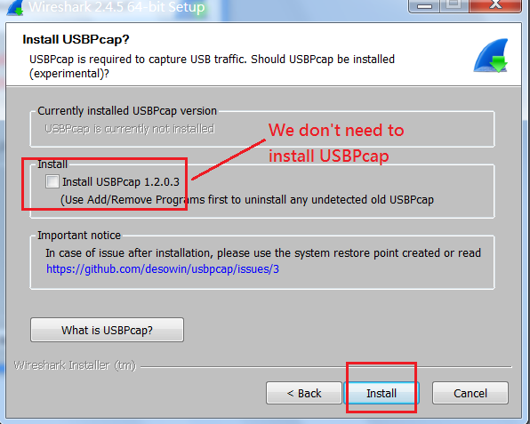
Lab 1.5 – Step 1: Install Wireshark (7)
P.<number>
Notes:
CT212 (02/03)-Network Programming and design
27 April, 2002
School of Science & Technology

Slide 15
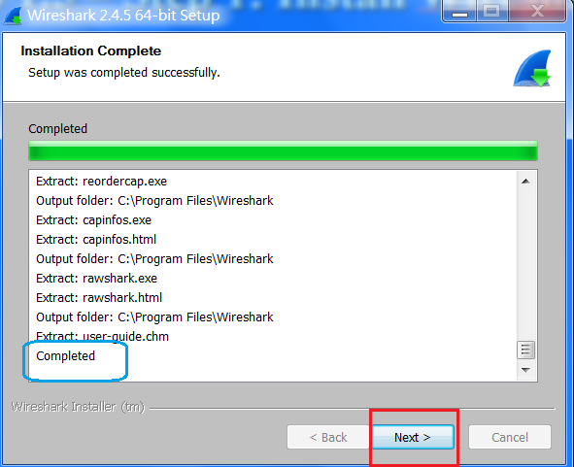
Lab 1.5 – Step 1: Install Wireshark (8)
P.<number>
Notes:
CT212 (02/03)-Network Programming and design
27 April, 2002
School of Science & Technology

Slide 16
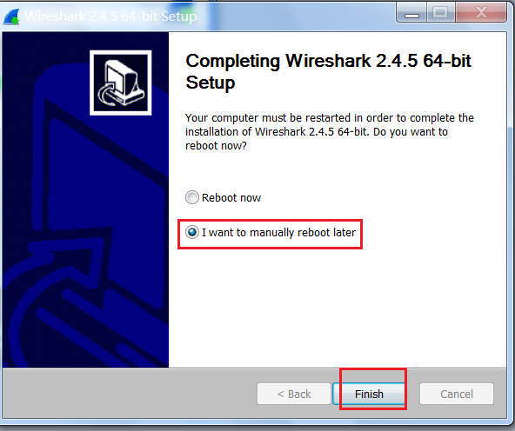
Lab 1.5 – Step 1: Install Wireshark (9)
P.<number>
Notes:
CT212 (02/03)-Network Programming and design
27 April, 2002
School of Science & Technology

Slide 17
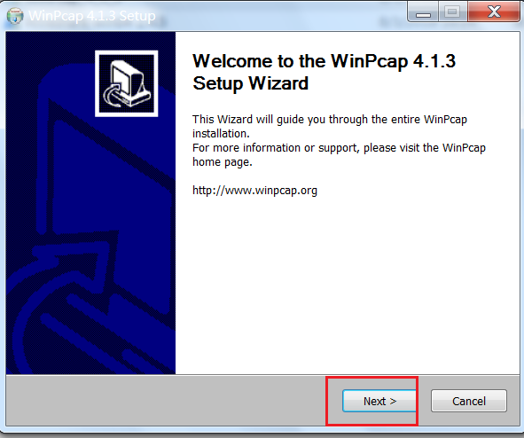
Lab 1.5 – Step 1: Install WinPcap (1)
P.<number>
Notes:
CT212 (02/03)-Network Programming and design
27 April, 2002
School of Science & Technology

Slide 18
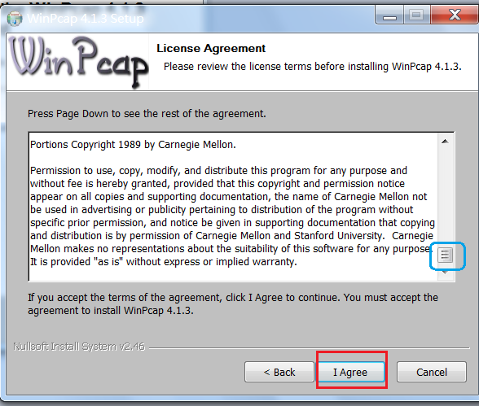
Lab 1.5 – Step 1: Install WinPcap (2)
P.<number>
Notes:
CT212 (02/03)-Network Programming and design
27 April, 2002
School of Science & Technology

Slide 19
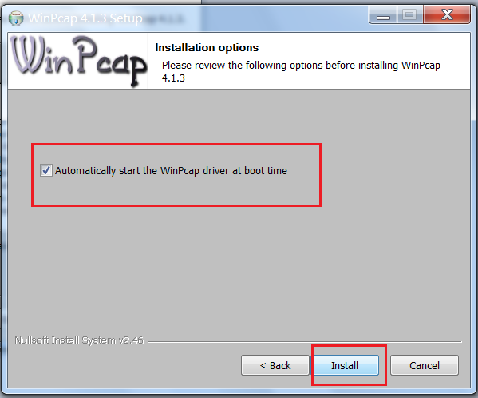
Lab 1.5 – Step 1: Install WinPcap (3)
P.<number>
Notes:
CT212 (02/03)-Network Programming and design
27 April, 2002
School of Science & Technology

Slide 20
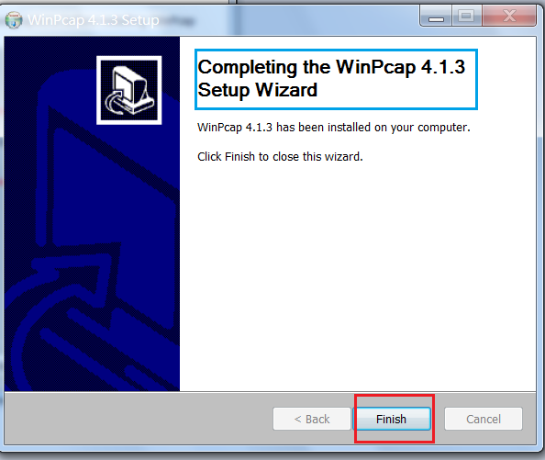
Lab 1.5 – Step 1: Install WinPcap (4)
P.<number>
Notes:
CT212 (02/03)-Network Programming and design
27 April, 2002
School of Science & Technology

Slide 21
Lab 1.5 – Step 2 (1)
Start Wireshark by clicking “Start” -> “All Programs” -> “Wireshark”
Start capture
  click “Capture” -> “Options”
  Select interface to capture traffic. Then click “start”
Stop capture by clicking “Capture -> “Stop”
P.<number>
Notes:
CT212 (02/03)-Network Programming and design
27 April, 2002
School of Science & Technology

Slide 22
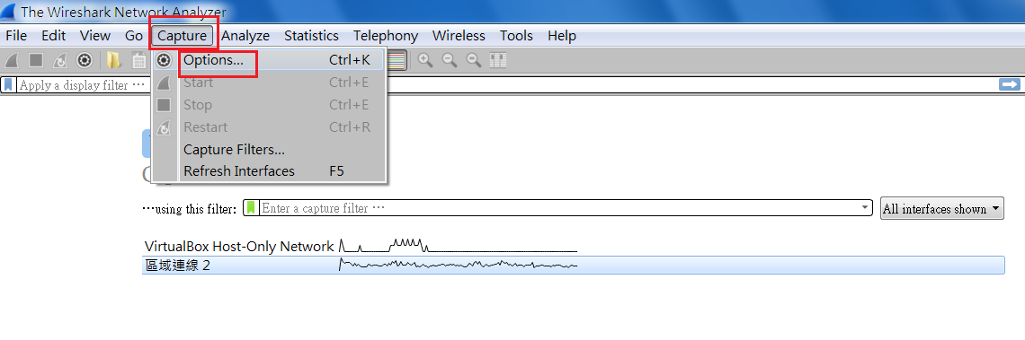
Lab 1.5 – Step 2: Specify Interface (1)
P.<number>
Notes:
CT212 (02/03)-Network Programming and design
27 April, 2002
School of Science & Technology

Slide 23
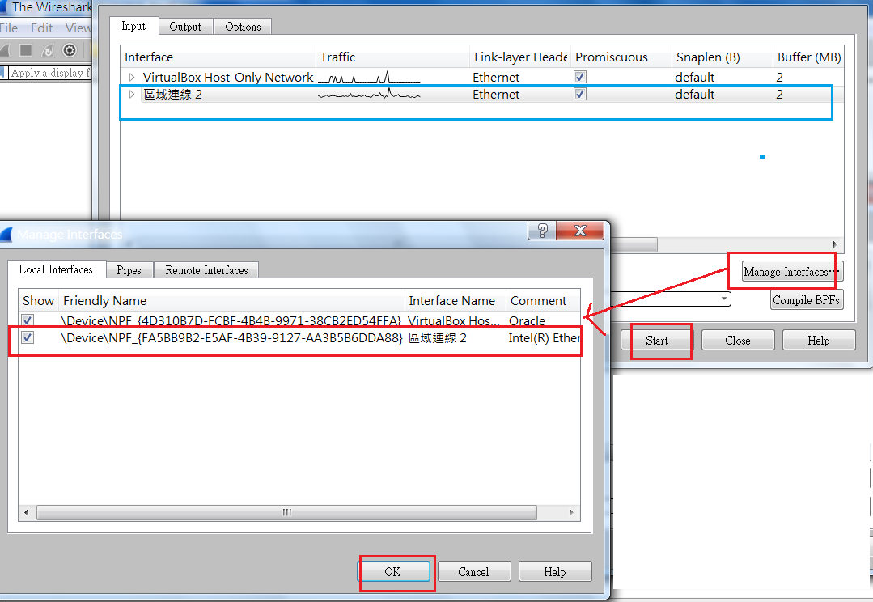
Lab 1.5 – Step 2 : Specify Interface (2)
Start capture
P.<number>
Notes:
CT212 (02/03)-Network Programming and design
27 April, 2002
School of Science & Technology

Slide 24
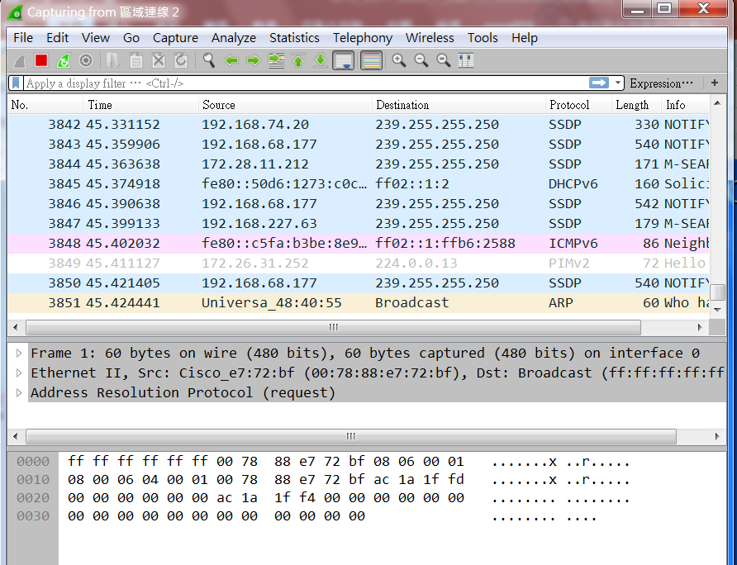
Lab 1.5 – Step 2 : start capture
Capture real time traffic continuously
P.<number>
Notes:
CT212 (02/03)-Network Programming and design
27 April, 2002
School of Science & Technology

Slide 25
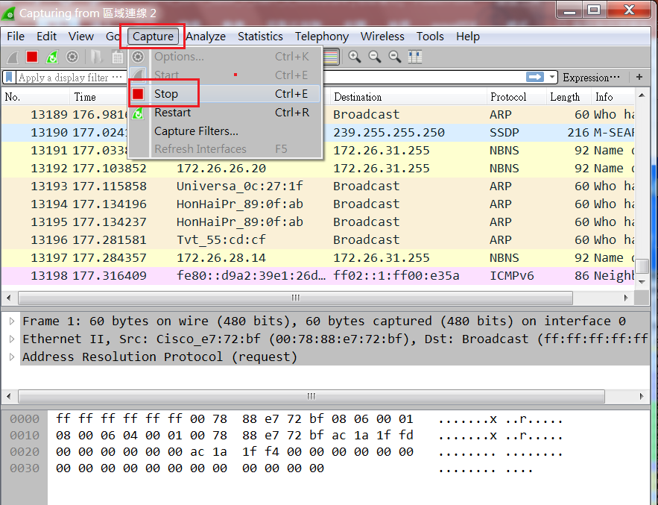
Lab 1.5 – Step 2 : Stop Capture
Stop capture by clicking “Capture -> “Stop”
P.<number>
Notes:
CT212 (02/03)-Network Programming and design
27 April, 2002
School of Science & Technology

Slide 26
Lab 1.5 – Step 3: filter (1)
You can filter traffic to be captured by using display filter
Following display filters can be tried by yourself
  http => HTTP traffic only
  icmp => ICMP traffic only
  http/dns => HTTP or DNS traffic
  tcp.port==22 => only traffic on tcp src or destination port 22
  ip.addr== 192.168.1.0 => only traffic to or from IP address 192.168.1.0
  ip.addr == www.google.com => any packet to or from www.google.com
  http.host=www.google.com => http packet to or from www.google.com
P.<number>
Notes:
CT212 (02/03)-Network Programming and design
27 April, 2002
School of Science & Technology

Slide 27
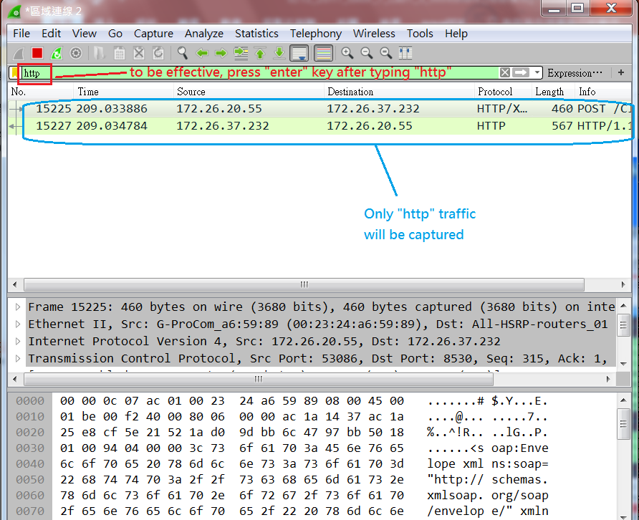
Lab 1.5 – Step 3 : filter (2)
Display filter for “http”
P.<number>
Notes:
CT212 (02/03)-Network Programming and design
27 April, 2002
School of Science & Technology

Slide 28
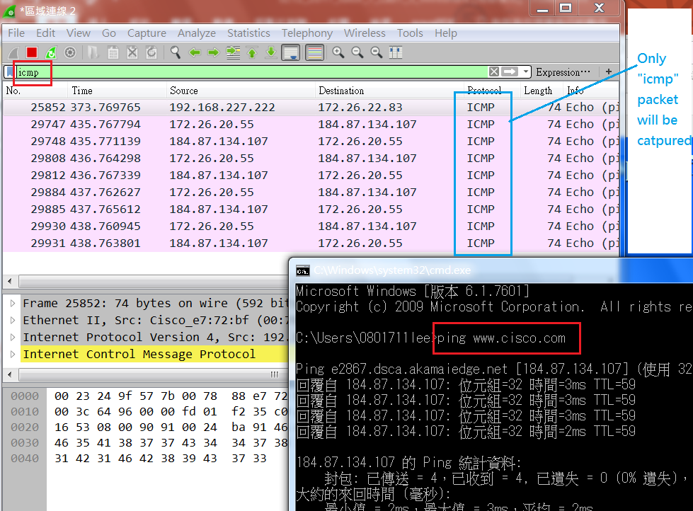
Lab 1.5 – Step 3 : filter (3)
Display filter for “icmp”
P.<number>
Notes:
CT212 (02/03)-Network Programming and design
27 April, 2002
School of Science & Technology

Slide 29
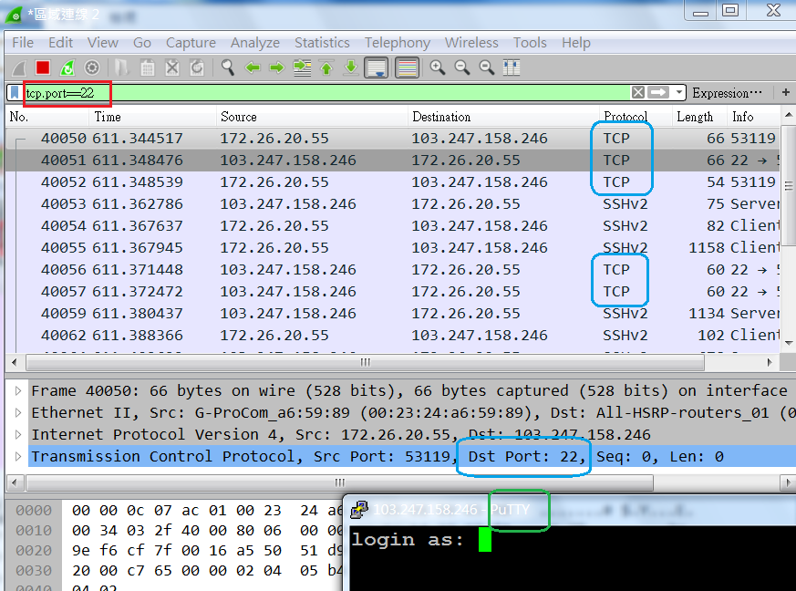
Lab 1.5 – Step 3 : filter (4)
Display filter for “tcp.port==22”
P.<number>
Notes:
CT212 (02/03)-Network Programming and design
27 April, 2002
School of Science & Technology

Slide 30
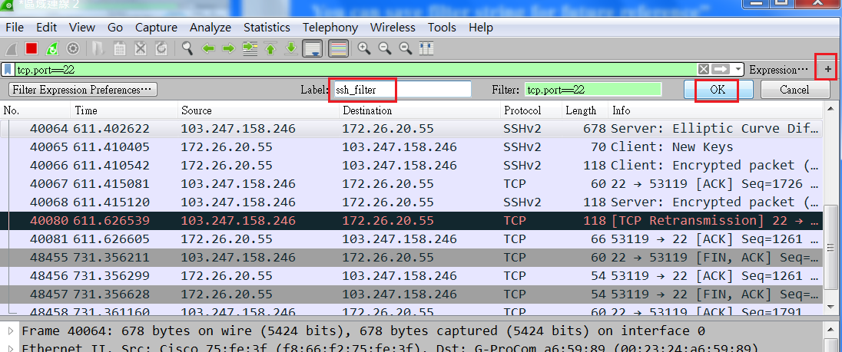
Lab 1.5 – Step 3 : filter (5)
You can save filter string for future usage”
P.<number>
Notes:
CT212 (02/03)-Network Programming and design
27 April, 2002
School of Science & Technology

Slide 31
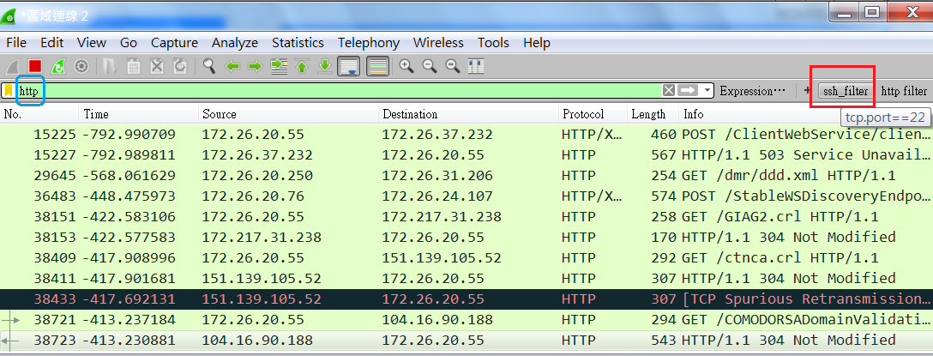
Lab 1.5 – Step 3 : filter (6)
Re-use saved filter “ssh_filter”
P.<number>
Notes:
CT212 (02/03)-Network Programming and design
27 April, 2002
School of Science & Technology

Slide 32
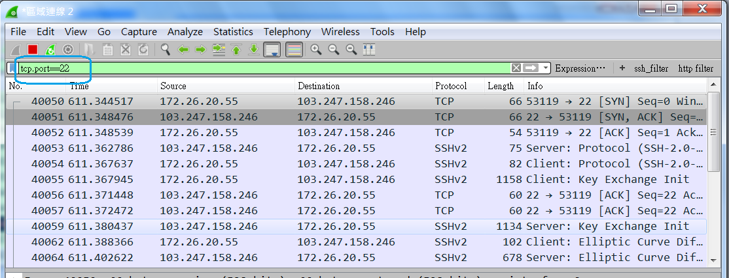
Lab 1.5 – Step 3 : filter (7)
Re-use saved filter “ssh_filter”
P.<number>
Notes:
CT212 (02/03)-Network Programming and design
27 April, 2002
School of Science & Technology

Slide 33
Lab 1.5 – Step 4 (1)
Capture username/password for web browsing (http)
  In Wireshark, capture traffic using filter “http.host==ucourse.ouhk.edu.hk”
  In browser, visit http://ucourse.ouhk.edu.hk/~t441051/protect/test.html
    Username=s1234567
    Password=apr09
  In Wireshark,
    click to select last packet in packet pane
    Click “triangle” sign for line “Hypertext Transfer Protocol” in analysis pane
    Click “triangle” sign for line “ Authorization” in analysis pane
    You should see the credentials: s1234567: apr09
P.<number>
Notes:
CT212 (02/03)-Network Programming and design
27 April, 2002
School of Science & Technology

Slide 34
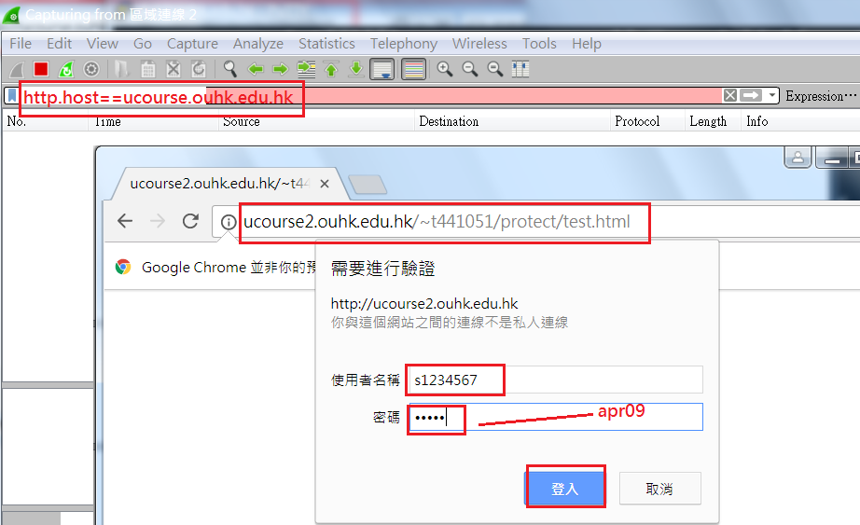
Lab 1.5 – Step 4 (2)
Capture username/password in http
P.<number>
Notes:
CT212 (02/03)-Network Programming and design
27 April, 2002
School of Science & Technology

Slide 35
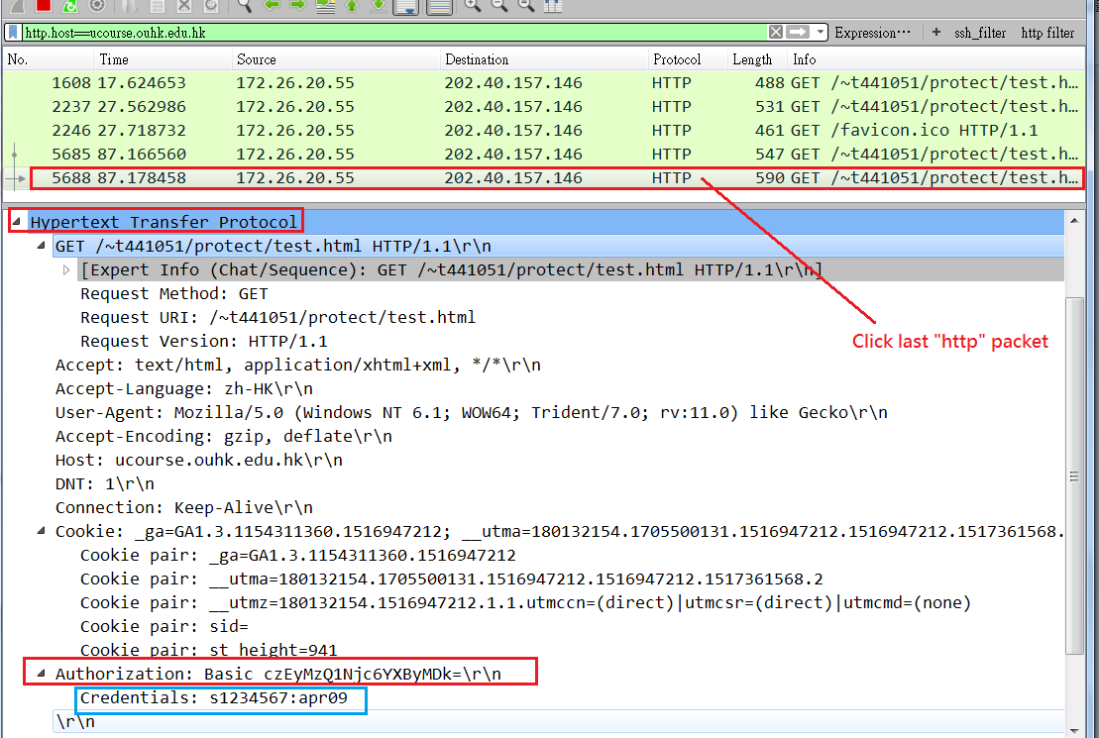
Lab 1.5 – Step 4 (3)
Capture username/password in http
P.<number>
Notes:
CT212 (02/03)-Network Programming and design
27 April, 2002
School of Science & Technology

Slide 36
Lab 1.5 – Step 4 (3)
Capture username/password for secure web browsing (https)
  Repeat steps in previous 2 slides except that browsing site changes to any https site which requires username/password (eg. Your online banking account)
  Your captured username/password should be encrypted => secure.
P.<number>
Notes:
CT212 (02/03)-Network Programming and design
27 April, 2002
School of Science & Technology

Slide 37
Lab 1.5 – Step 5
(Optional) To analyze wireless traffic,
  your PC must be equipped with an wireless network interface and
  You need to download & install Netstumbler
    Download URL: http://www.netstumbler.com/downloads/
  Netstumbler can easily detect wireless access points around. It also indicates which access points are running without encryption.
P.<number>
Notes:
CT212 (02/03)-Network Programming and design
27 April, 2002
School of Science & Technology

